Slide 1
Big Mountain Ski Resort
Price Analysis

Slide 2

Overview
- Problem identification
-Recommendation and Key Findings
-Modeling Results and Analysis
-Summary and Conclusion

Slide 3
Problems to solve
How does Big Mountain increase revenue to accurately reflect its market value?
1
2
How does Big Mountain lower expenses without affecting guest attendance?

Slide 4
Solutions
1
Increase ticket prices
Eliminate non profit generating amenities
Add revenue neutral amenities
2

Slide 5
Recommendations
Analysis shows that a price increase of $12.28 is justified based on value compared to other premium resorts
1
Shutting down 1 run shows no effect on revenue while lowering expenses
Increasing the vertical drop by 150 feet and installing an additional lift justifies a ticket price increase of $15.26
2

Slide 6
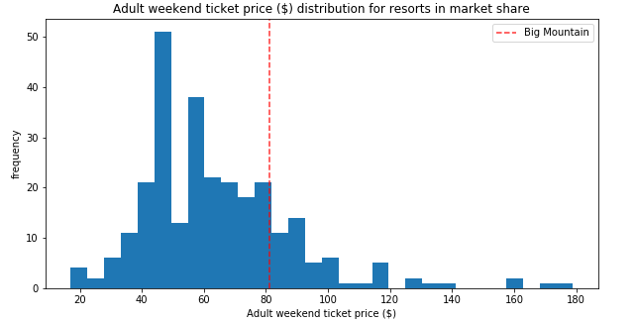
Analysis Data
Current price for an adult lift ticket is $81.00
Model predicts a price of $93.28 based on competitors and features

Slide 7
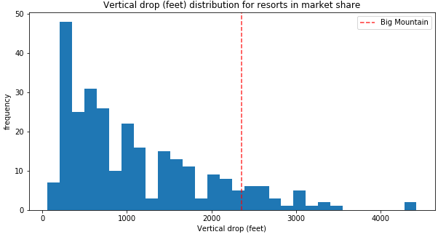
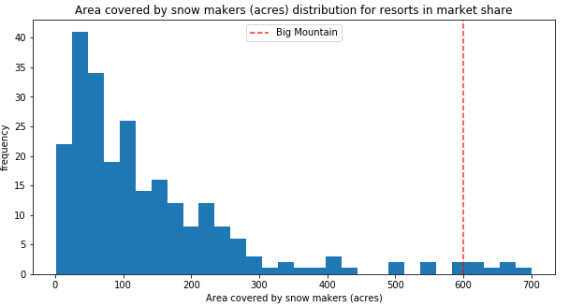
Analysis Data
Big Mountain is above the average in vertical drop and snow making acreage.

Slide 8
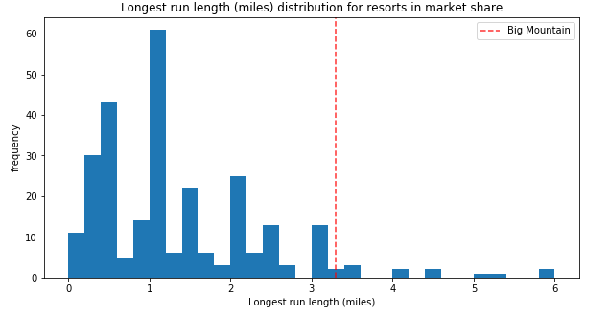
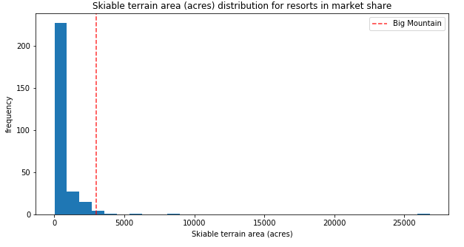
Analysis Data
Big Mountain is far and above the average in longest run and skiable terrain

Slide 9
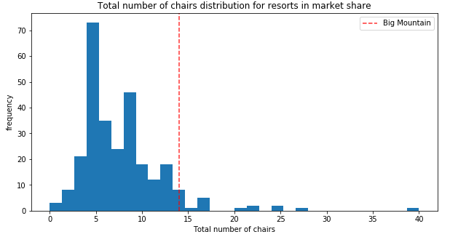
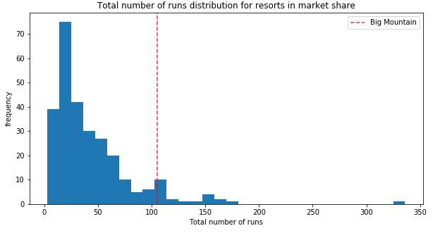
Analysis Data
Big Mountain is also top notch in number of chairs and total number of ski runs

Slide 10
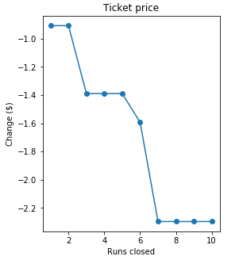
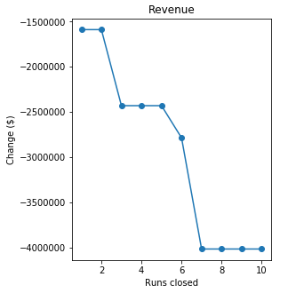
Analysis Data
Closing one run puts no downward pressure on ticket price or revenue and closing 2-5 runs has the same effect with a multiplied expense savings

Slide 11
Conclusion
The data shows that compared to other ski resorts and with top notch amenities and services Big Mountain Ski Resort is an undervalued resource and an increased price is justified based on their superior offerings.

Slide 12
Thank You!

